Slide 1
Supervised Models
Part 5
Dr. Nassim Sohaee

Slide 2
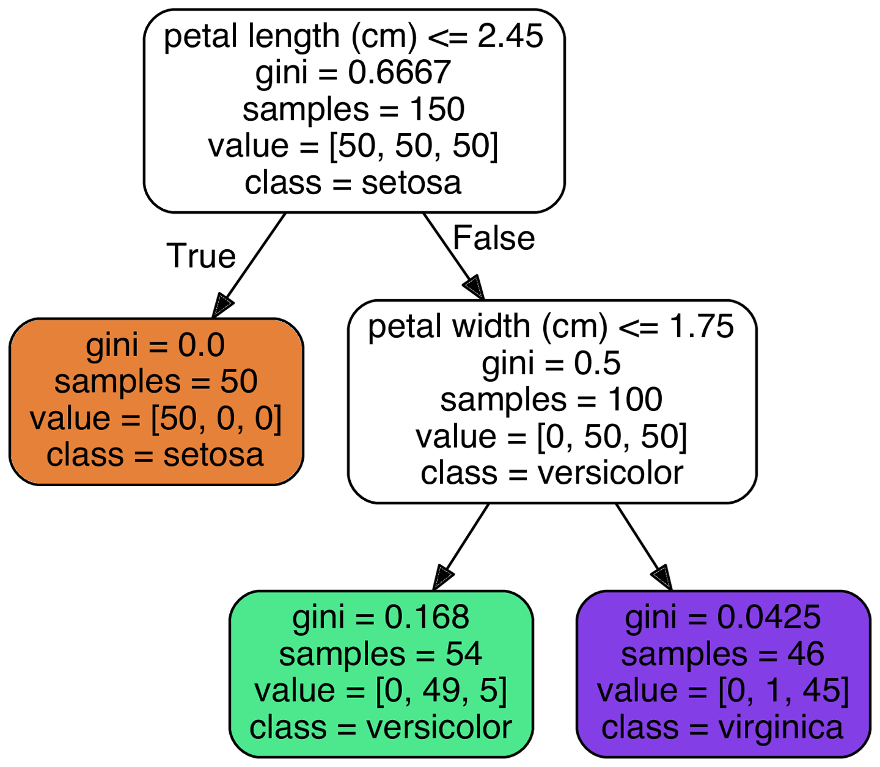
Decision Tree
[petal length, petal width]=[2.65, 1.60]

Slide 3
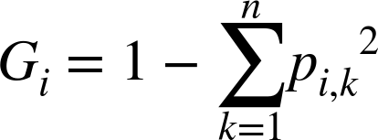
Making Prediction
Decision tree is not sensitive to scaling
A node is pure (gini = 0) if all the training instances it applies to belong to the same class.

Slide 4
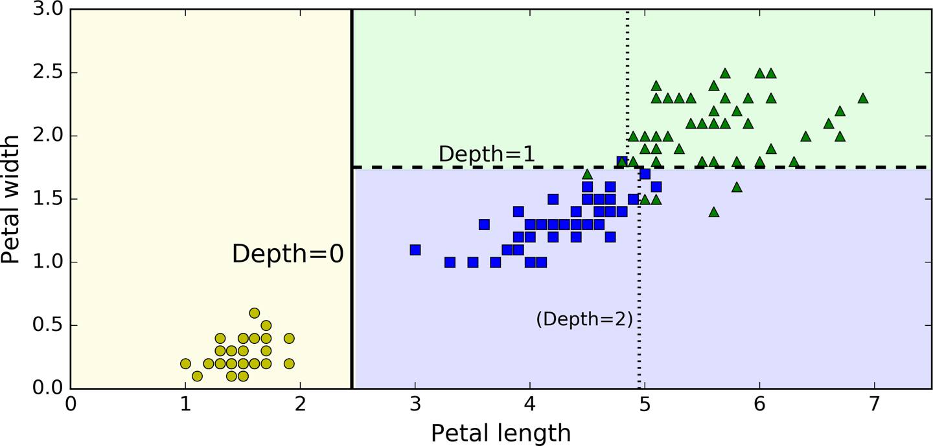
Note
Scikit-Learn uses the CART algorithm, which produces only binary trees

Slide 5
Estimating Class Probability
A Decision Tree can also estimate the probability that an instance belongs to a particular class k.
Setosa: 0/54 = 0
Versicolor: 49/54 = 0.907
Virginica: 5/49 = 0.093

Slide 6
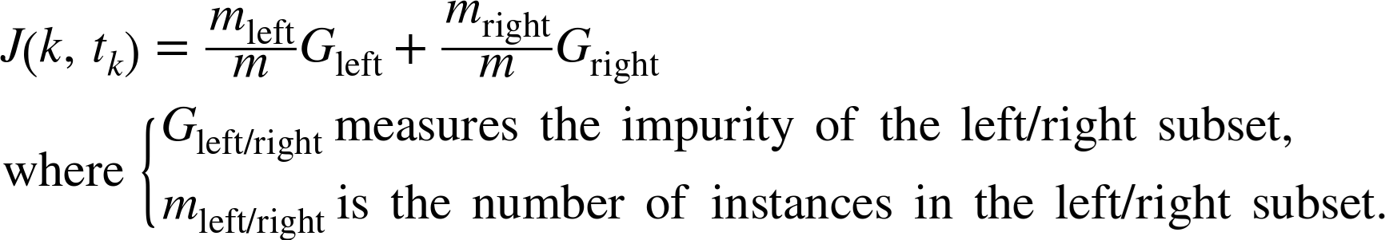
The CART Training Algorithm
Sci-kit learn uses Classification And Regression Tree (CART) algorithm to train Decision Trees.
CART is a greedy algorithm.

Slide 7
Computational Complexity
Prediction: O(log m)
Training: O(n log m)

Slide 8
Entropy
Default: Gini Impurity
criterion = 'entropy'
Entropy: originated in thermodynamics
Entropy = 0: molecules are still and well ordered
Larger entropy: random behavior
Information Content: average information content
Entropy = 0: all messages are identical
Higher entropy: higher differences

Slide 9
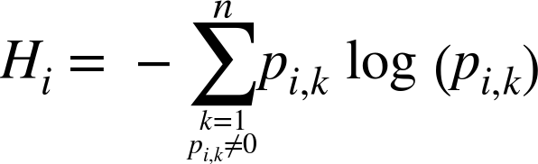
Entropy
Entropy of the i-th node
Probability of class k in i-th node
-49/54 log(49/54) - 5/54 log(5/54) ≈ 0.31

Slide 10
Gini or Entropy?
Gini impurity is faster to compute
Entropy tends to produce more balanced trees.

Slide 11
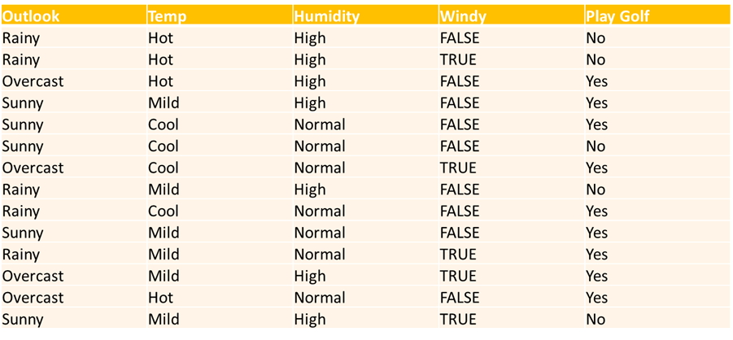
Example

Slide 12
ID3 Algorithm
The core algorithm for building decision trees is greedy search through the space of possible branches with no backtracking.
This algorithm uses Entropy and Information Gain to construct a decision tree.

Slide 13
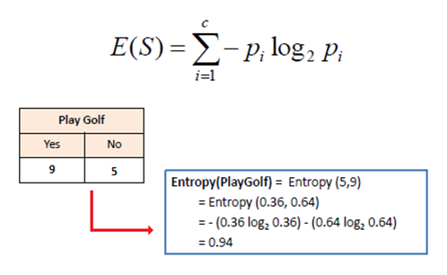
Entropy
To build a decision tree, we need to calculate two types of entropy using frequency tables as follows:
Entropy using the frequency table of attribute:

Slide 14
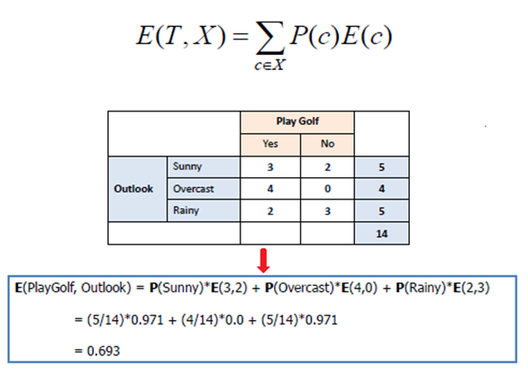
Entropy
2. Entropy using the frequency table of two attributes:

Slide 15
Information Gain
The information gain is based on the decrease in entropy after a dataset is split on an attribute.
Constructing a decision tree is all about finding attribute that returns the highest information gain
The most homogeneous branches.

Slide 16
Step 1
Calculate entropy of the target.
Entropy(PlayGolf)
= Entropy(5,9)
= Entropy(0.36, 0.64)
= 0.36 log⁡(0.36) -0.64 log(0.64)
= 0.94

Slide 17
Step 2:
The dataset is then split on the different attributes.
The entropy for each branch is calculated.
Then it is added proportionally, to get total entropy for the split.
The resulting entropy is subtracted from the entropy before the split.
The result is the Information Gain, or decrease in entropy.

Slide 18
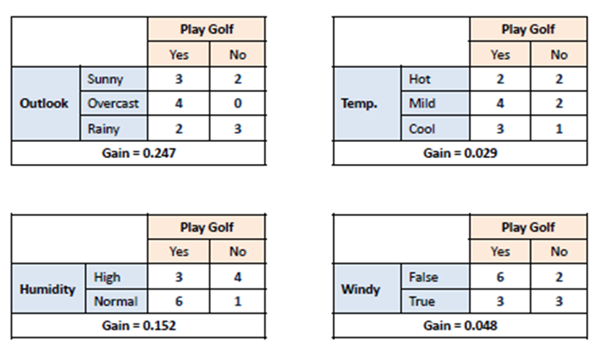
Step 2:

Slide 19
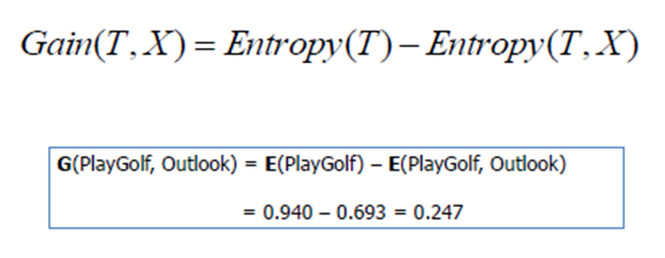
Step 2:

Slide 20
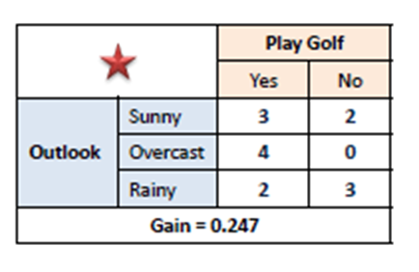
Step 3:
Choose attribute with the largest information gain as the decision node, divide the dataset by its branches and repeat the same process on every branch.

Slide 21
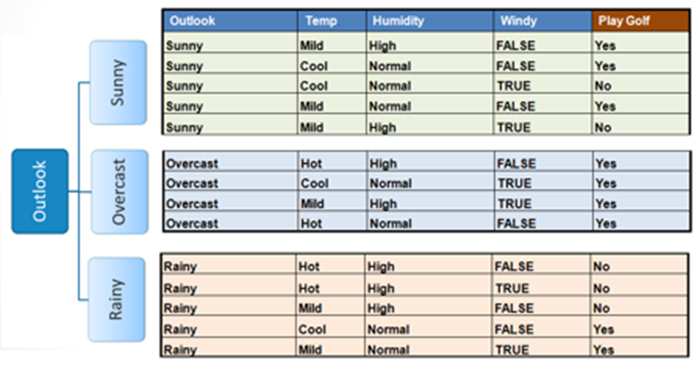
Step 3:

Slide 22
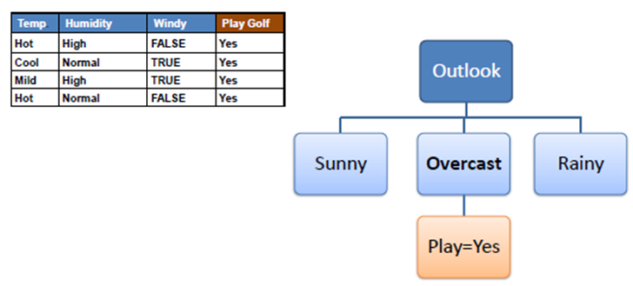
Step 4a:
A branch with entropy of 0 is a leaf node.

Slide 23
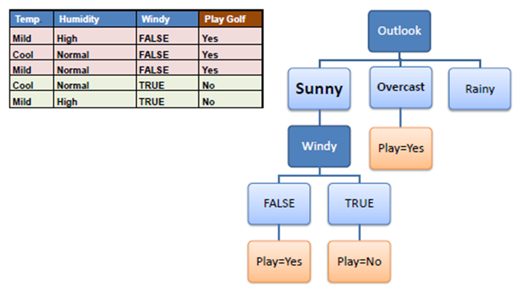
Step 4b:
A branch with entropy more than 0 needs further splitting.

Slide 24
Step 5:
The algorithm is run recursively on the non-leaf branches, until all data is classified.

Slide 25
Decision Tree Regressor

Slide 26
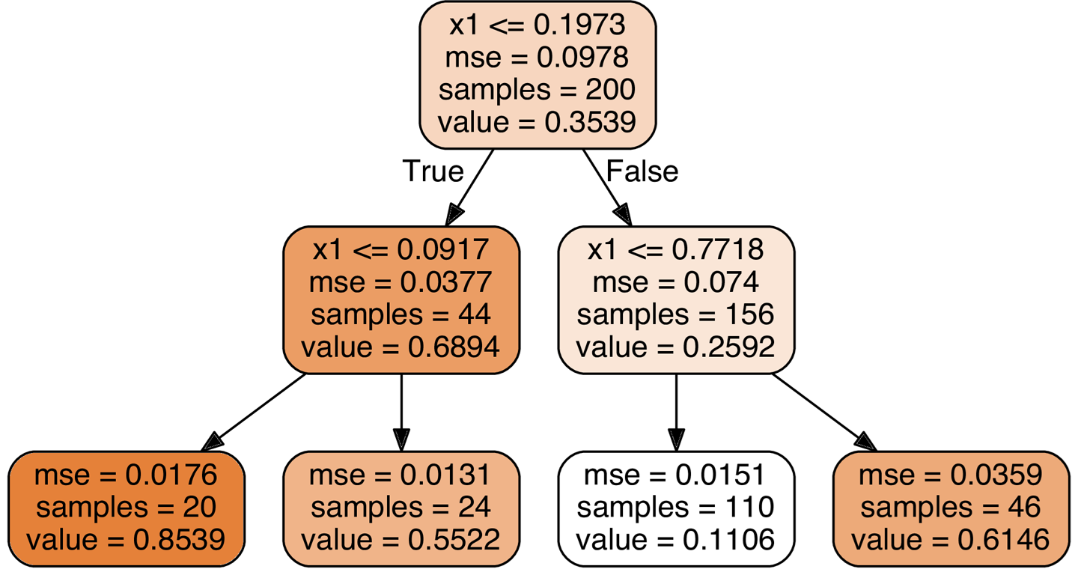
Regression
x1 = 0.6

Slide 27
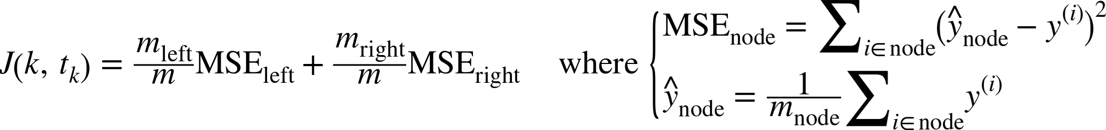
CART Algorithm

Slide 28
